Slide 1



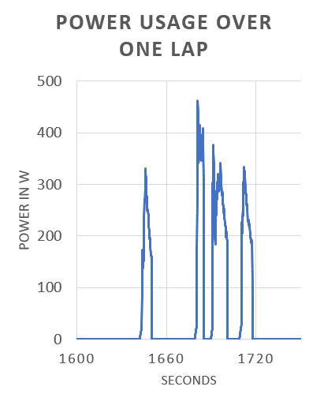
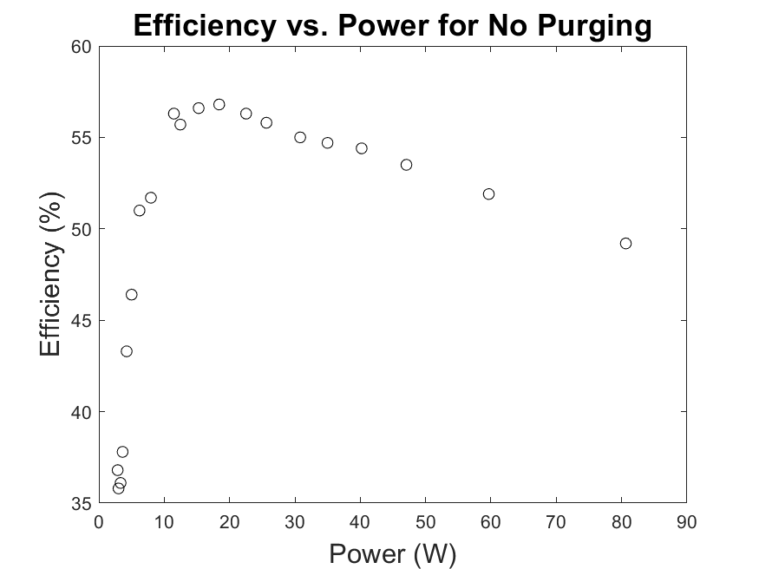
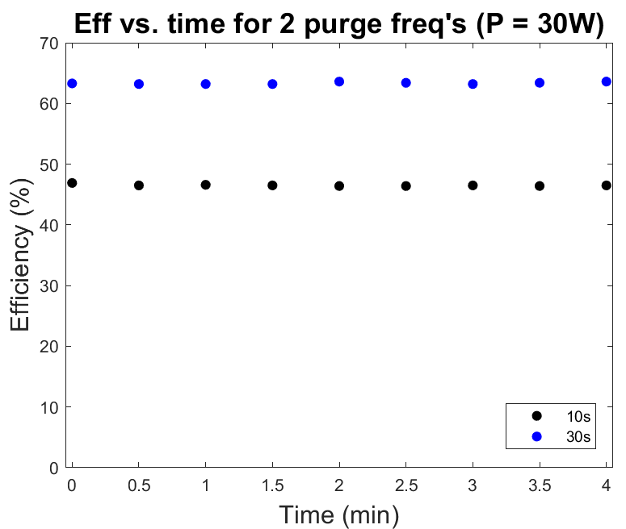
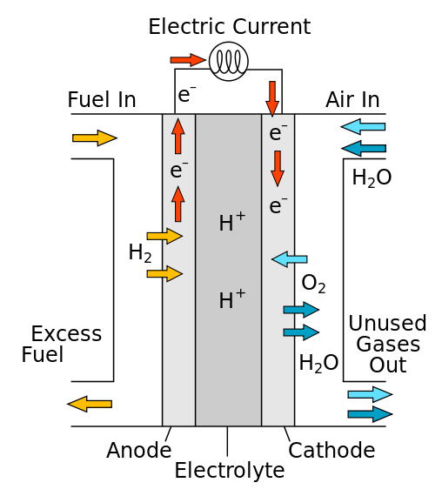
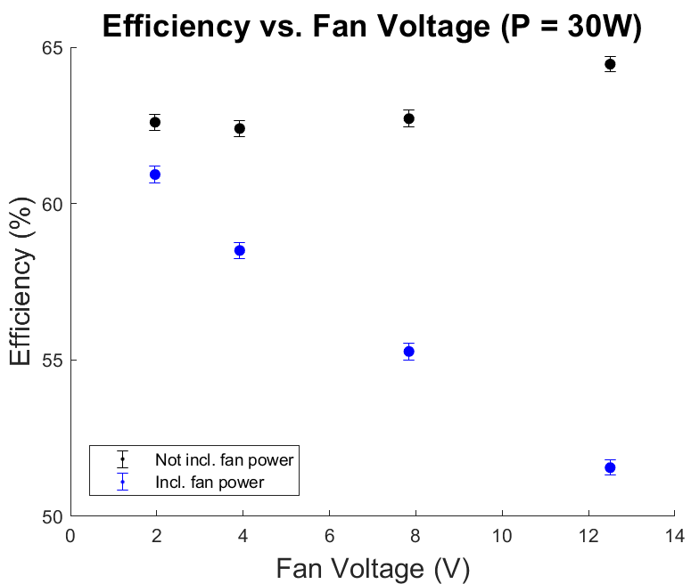
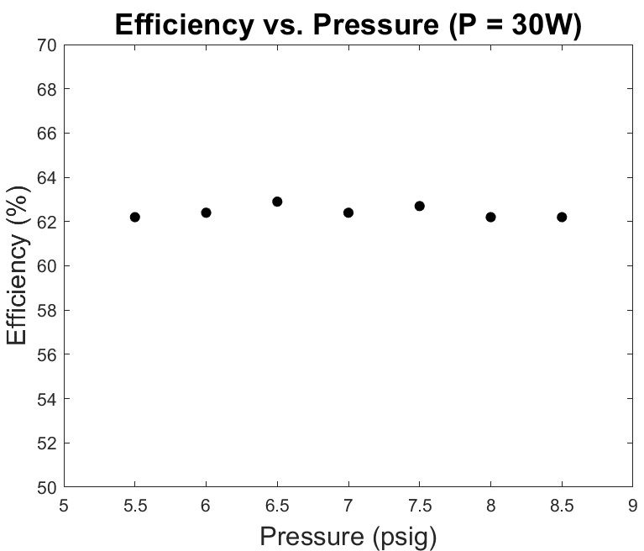
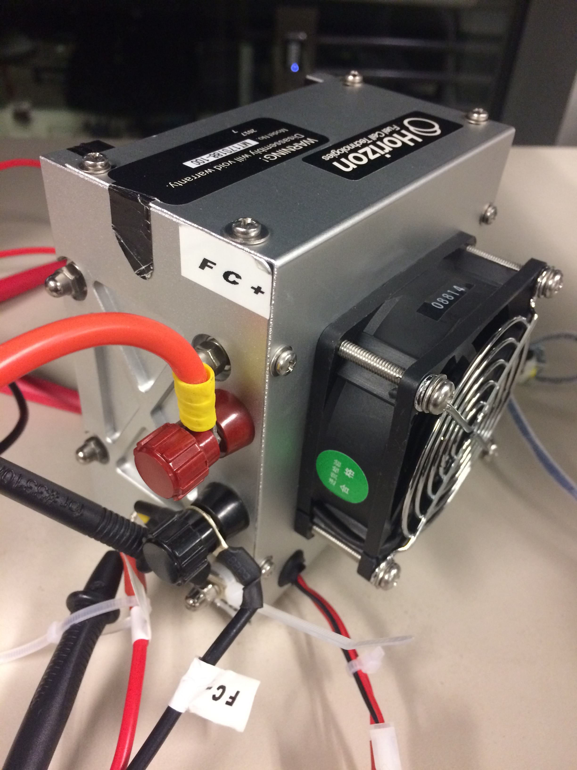
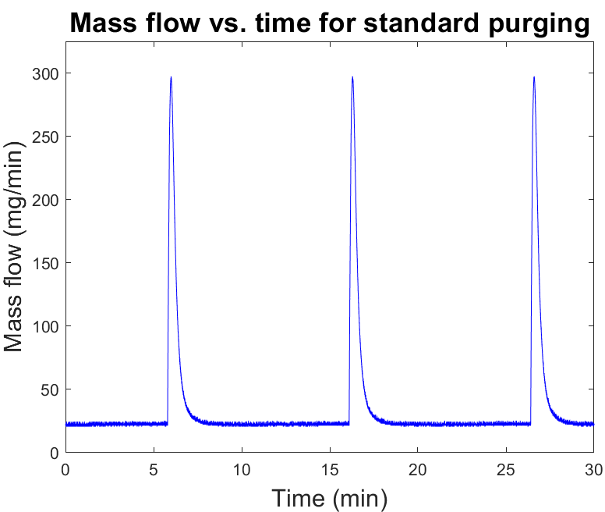
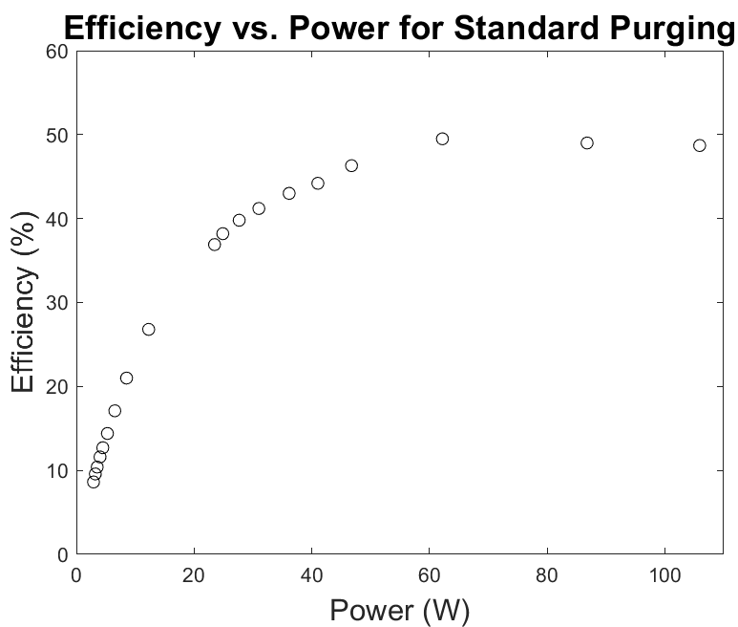
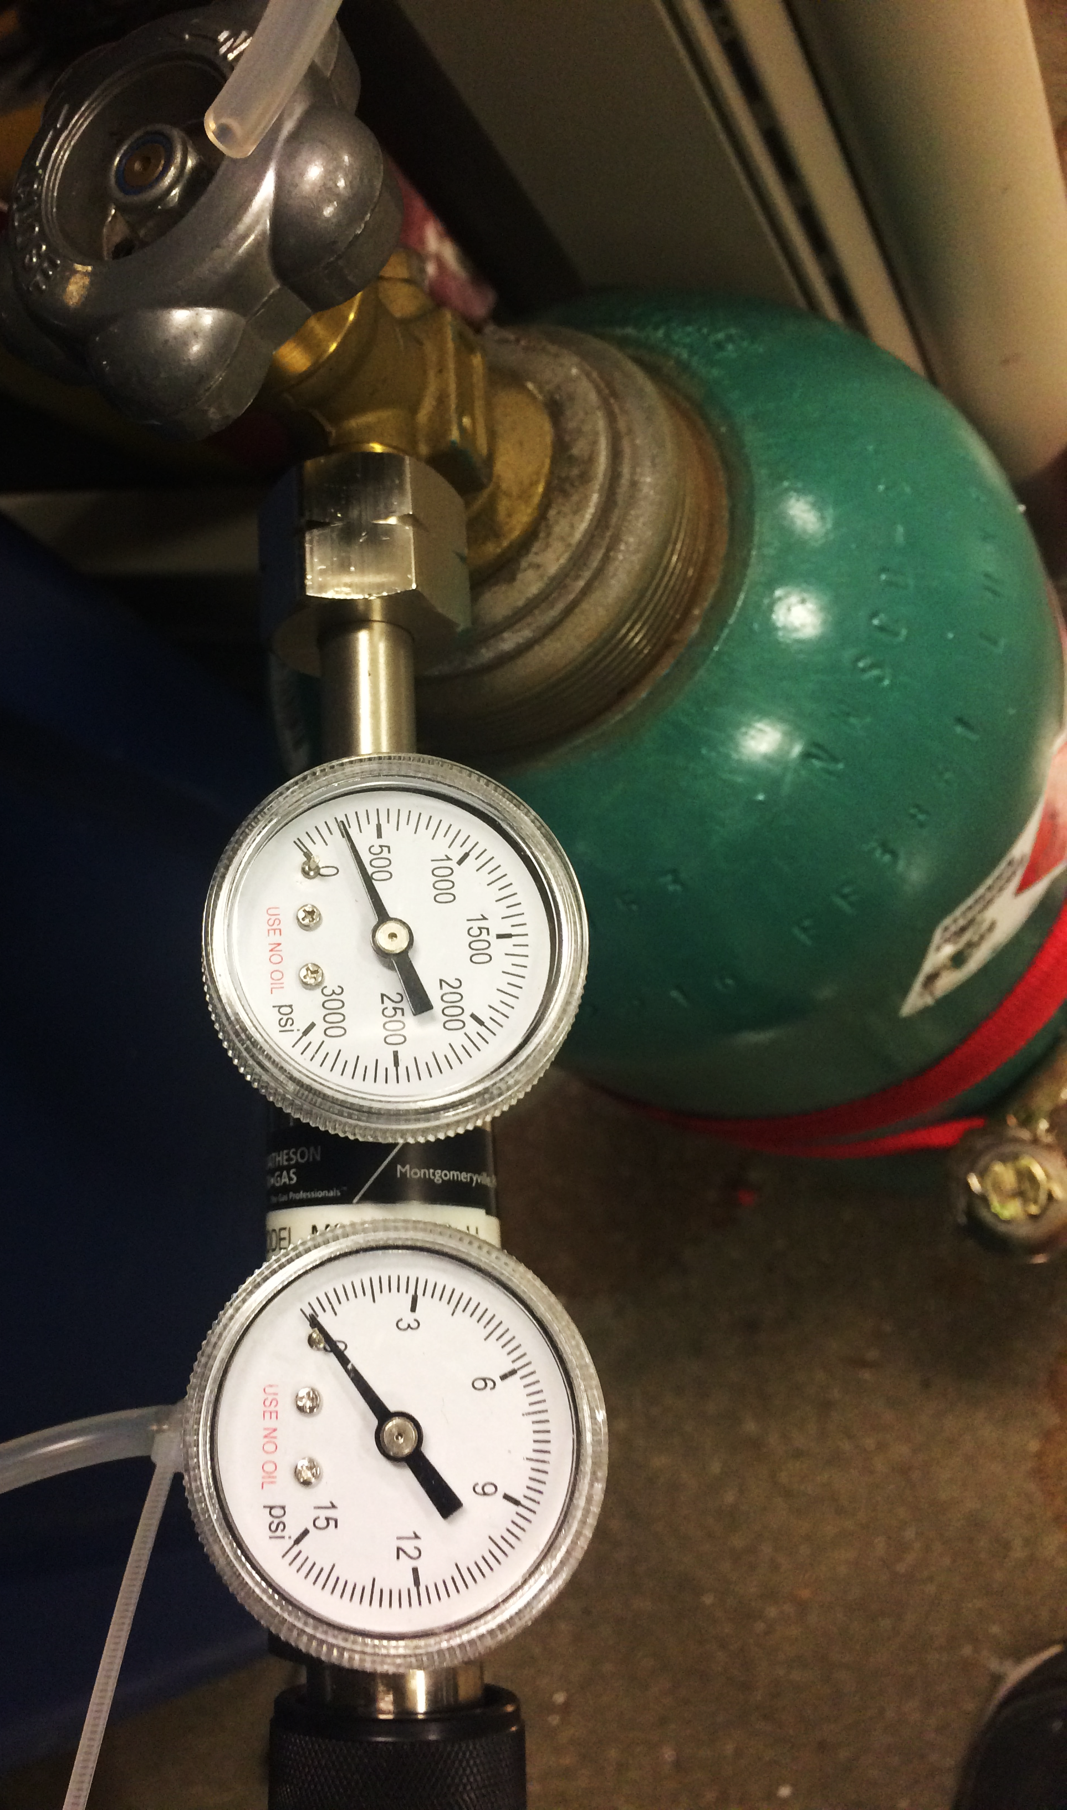
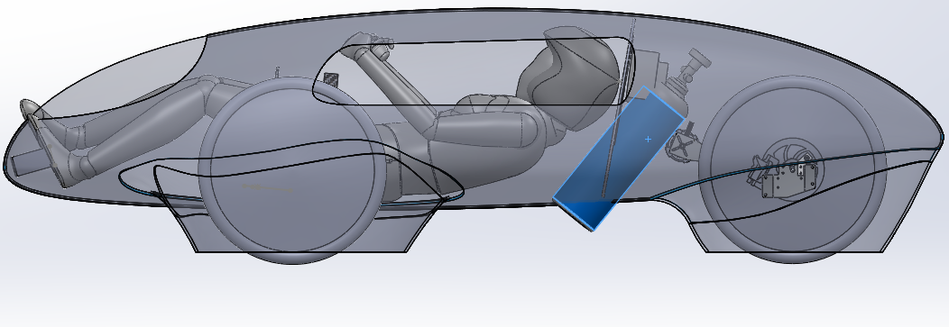
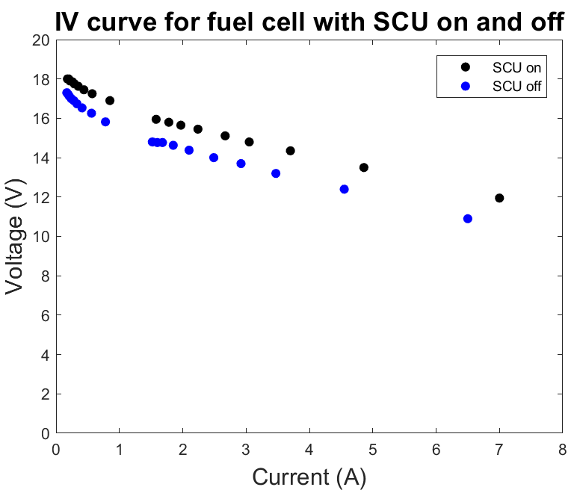
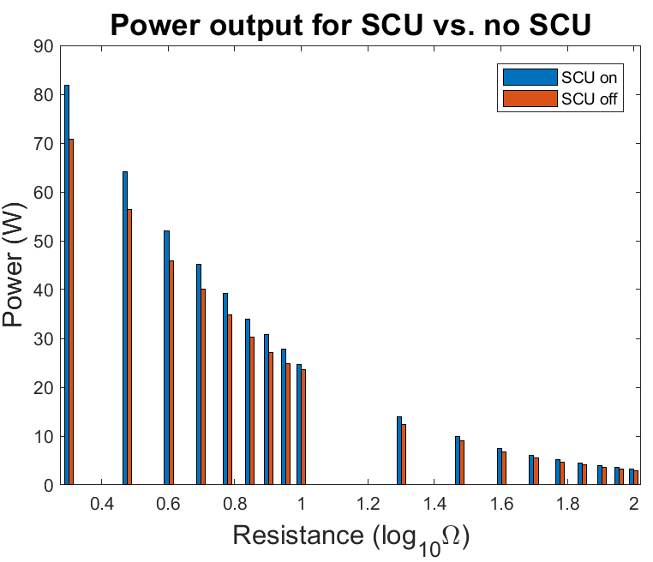
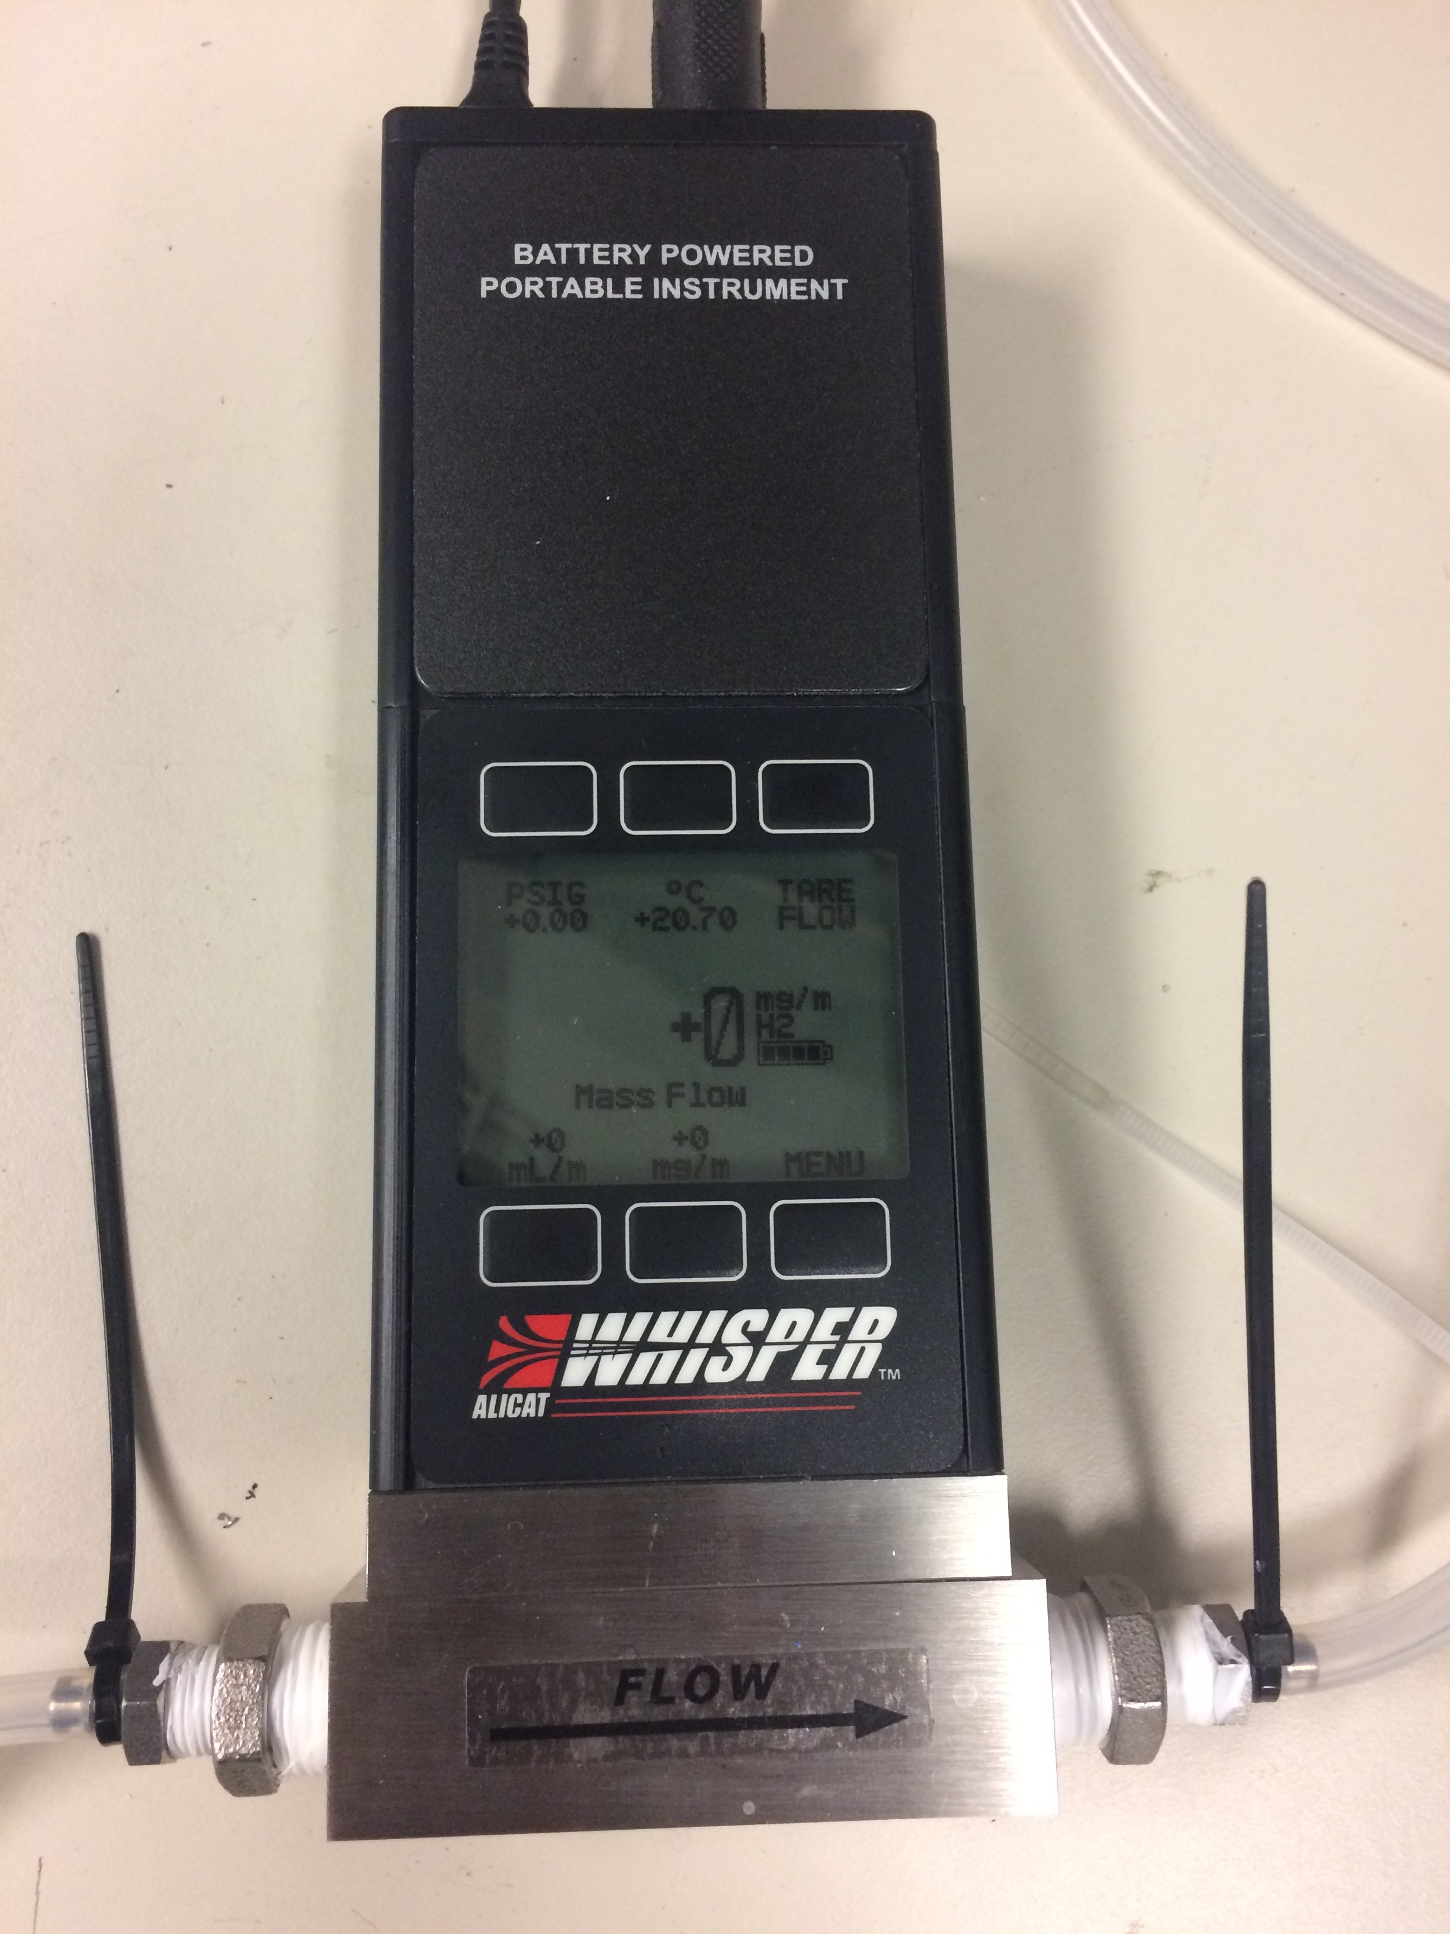
Optimizing the operational efficiency of a PEM hydrogen fuel cell for applications in a hybrid electric vehicle
Gerry Chen¹, Shomik Verma¹, Patrick Grady¹, Nico Hotz², Josiah Knight²
¹Duke Electric Vehicles Team
²Mechanical Engineering and Materials Science Department
Background
Energy Storage
Fuel Cell Optimization
Duke Electric Vehicles competes in the Shell Eco-Marathon annually
1st place Battery-Electric Prototype at 2017 competition
296 mi/kWh
Equivalent to 9,976 MPG-e
Expanding to hydrogen fuel cell category for 2018
Eco-Marathon is competition for efficiency
Previously: optimize aerodynamics, rolling resistance, weight, motor controller, battery management system
New considerations with hydrogen fuel cell (H2FC) implementation in the electric vehicle
Car speed kept constant to minimize aerodynamic losses
Motor is off for majority of lap due to track elevation profile
Power demanded in short, powerful bursts
Energy storage system developed to allow FC to store energy in supercapacitor bank
Motor draws directly from this bank in bursts.
Power converter is fully controllable
Operates at 96% efficiency
Allows fuel cell to be run at its optimal point.
Decreasing purge frequency improved efficiency
No significant decrease in efficiency over time
Reducing fan speed rapidly dropped power
Change in temperature over time?
Increasing pressure improved(?) efficiency
Objective
Motor
Fuel Cell
Controllable Step-Up Converter
Supercapacitor Bank
Goal: optimize H2FC to maximize efficiency
Variables: humidity, temperature, pressure, purging frequency, fan speed, short circuit
Change operating conditions of commercial fuel cell by controlling variables
Reduce variability in load to fix operating point
Vehicle power has significant spikes in load during acceleration or climbing hills, while is constant and low while driving on flat roads
Background
Fuel Cell Characterization
Commercial Horizon 100W PEM fuel cell
Rated for 40% at 100W
Standard operating points:
7.5 psig inlet hydrogen pressure
10s purging frequency for 100ms
10s SCU frequency for 100ms
Fan speed PWM 12% on at 12 V
Methods
Conclusions and Next Steps
Optimize H2FC operational efficiency
Generate IV curve for the fuel
Derive power curve as a function of load
Use flowmeter to determine efficiency vs. load
Change variables, determine impact on efficiency
Setup:
Compressed hydrogen tank + pressure regulator
Flowmeter attached between tank and H2FC
Slide resistors to manually change load
2 multimeters to determine voltage and current at each load value (voltmeter connected in parallel with fuel cell, ammeter in series)
Energy in with flowmeter, energy out by IV curve
Determine best way to vary controllable variables:
Humidity, temperature, pressure, purging frequency, fan speed, short circuit
Focused on pressure, purging frequency, fan speed: have biggest impact on efficiency
Pressure: inlet pressure of hydrogen
Purging: commercial fuel cell purges excess hydrogen + humidity every 10 s.
Fan speed: cools fuel cell and provides air
Planning to run fuel cell at constant 50W
Predicted efficiency is 53.5%
Significant improvement over varying fuel cell load: 22% more efficient
Optimal running parameters:
No purging, fan on, pressure 7.5 psig
Next steps:
Experiment with inlet humidity effects
Isolate air flow from temperature
Implementation of H2FC in vehicle (redesign)
References
Performance Improvement by Temperature Control of an Open- Cathode PEM Fuel Cell System. Strahl et al. Institut de Robòtica i Informàtica Industrial. Fuel Cells 14. No. 3, 466-478. March 2014.
Optimal Temperature Control in PEM Fuel Cells. Riascos and Pereira. Federal University of ABC. IEEE 2009.
Predictive Control of Voltage and Current in a Fuel Cell-Ultracapacitor Hybrid. Greenwell and Vahidi. Clemson University. IEEE Transactions on Industrial Electronics, Vol 57, No. 6, June 2016.
Diagram of a proton conducting solid oxide fuel cell. Dervisoglu. May 2012

